Slide 1
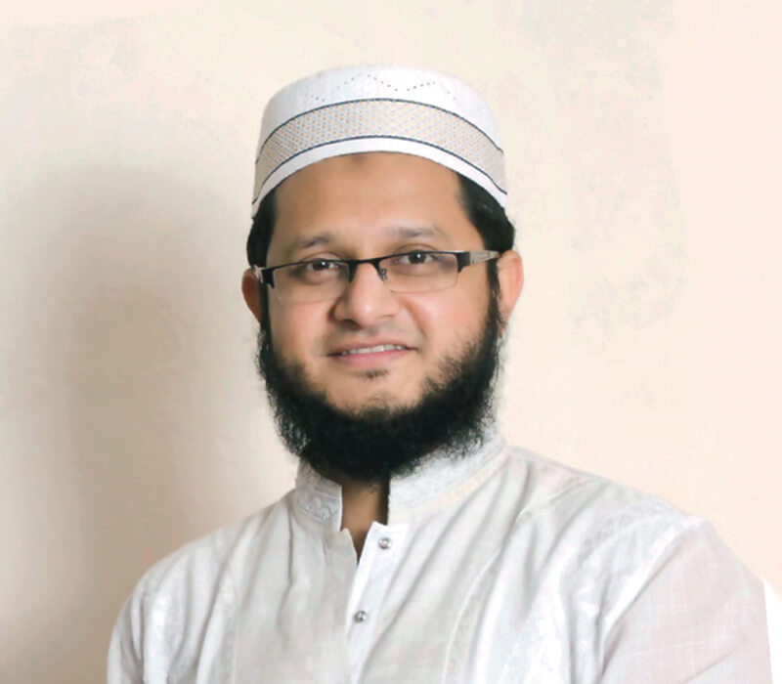

Presentation on
MAhmudul Hasan SOhag
group-03
“Falling down is not defeat,
defeat is when someone refuses to get up”

Slide 2

Presented By:
01.
03.
02.
04.
Sumaiya Momotaz Mrittika
Silma tasnim
1) Company Overview
2) Basic Info of Entrepreneur
1) Source of Fund, Problems
2) Learnings from Entrepreneur
Miftahul zannat
Sumaiya hossain surovi
1) Reasons of Venture
2) Attributes of success
1) Contribution, Conclusion
2) Recommendation

Slide 3



Company Overview
Onnorokom Group
Udvash
Unmesh
Rokomari.com
Onnorokom Software
Onnorokom Electronics
Onnorokom Prokashoni
Pi Labs
TechShopBD

Slide 4

Basic Info of the Entrepreneur
Name : Mahmudul Hasan Shohag
Co-Founder and Chairman Of OnnoRokom Group
Birthplace: Shorishabari , Jamalpur
Moving to Dhaka for study
Student of EEE in BUET
Establishment of UDVASH

Slide 5
Reasons For Starting VEnture
Fascination
Interest
Ambition
Fascination with teaching
Interest in programming
Ambitious for becoming an entrepreneur

Slide 6
keys components of Business/Driving force
Mission
Planning strategy
Management
Value proposition
Target market
Customer focus

Slide 7
Attributes of Success
Visionary Leadership
Ability to articulate this vision.
Rallying the team around common goals.
Resilience
Resilience in navigating challenges and uncertainties.
Risk-taking
Innovation
willing to take calculated risks
Innovative ideas and entrepreneurial initiatives.

Slide 8
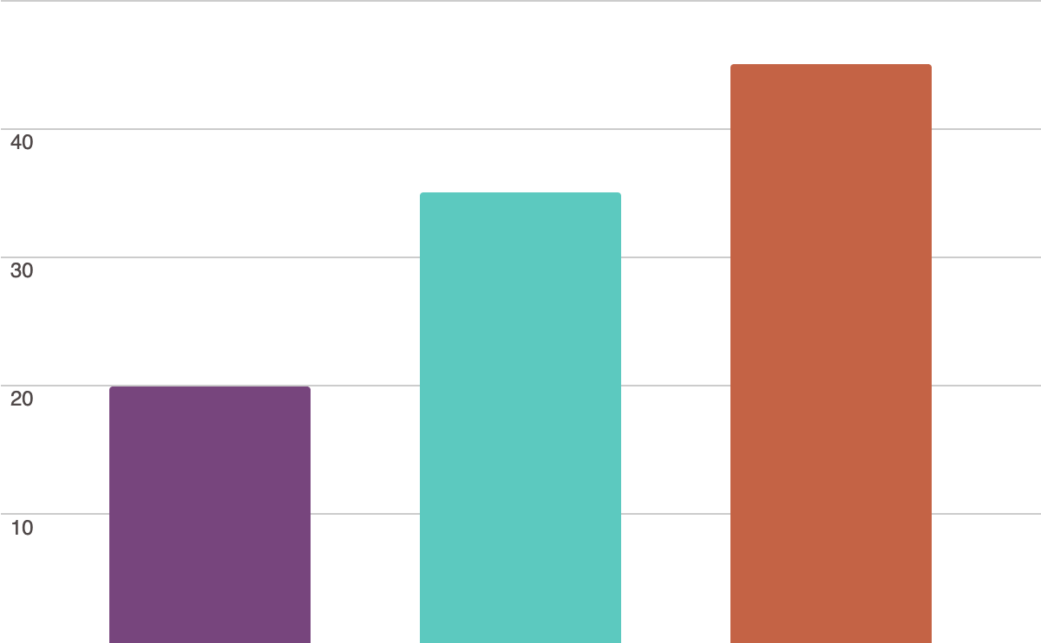
Growth of business
20%
35%
45%
2006
The growth was not so good.
2008
Started growing gradually.
2013
Achieved a lot.

Slide 9
Source of fund
Personal
Savings
Family and Friends
Angel
Investors
Venture
Capital
Bank
loans

Slide 10
Problems
Lack of
fundings
Market Uncertainty
Hiring and Talented Acquisition
Risk Management
Marketing and Branding

Slide 11
Learning from the entrepreneur
Embrace Failure
Take Calculated Risks
Focus on Customer Needs
Learn Continuously
Adaptability is Key
Surround Yourself with a Strong Team
Be Resilient
Network and Seek Mentorship
Value Customer Feedback

Slide 12


Contribution to the country / economy
According to Sohag, in total, the company pays up to approximately 5,000 people every month.
helps to reduce unemployment problems
increasing the country's investments, production and trade activities
encourages students to research in the Tech field
contributes to government revenue through taxes
Udvash-Unmesh helps a lot of students to get admitted in their dream University or Medical Colleges

Slide 13
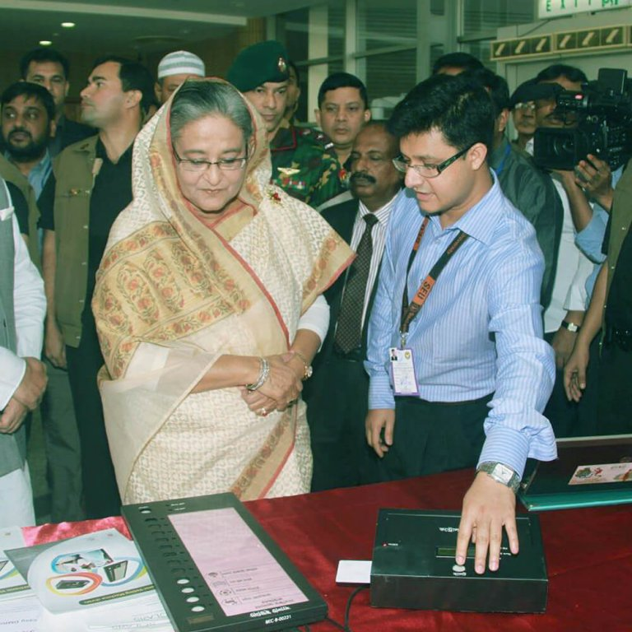
Conclusion
At Onnorokom Group, from being an only 2-member venture, he now has a team of 1,100 people working at the company.
Under Mahmudul Hasan Sohags’ leadership,Onnorokom Group has been instrumental in driving digitalization and promoting technological advancements in the Bangladesh.

Slide 14
recommendations
New addition to rokomari
market research and planning
prioritize the needs of the customers
Monitor cash flow and profitability
build trust among employees
consider all feedbacks positively

Slide 15

Feel free to ask any Question………..

